Slide 1
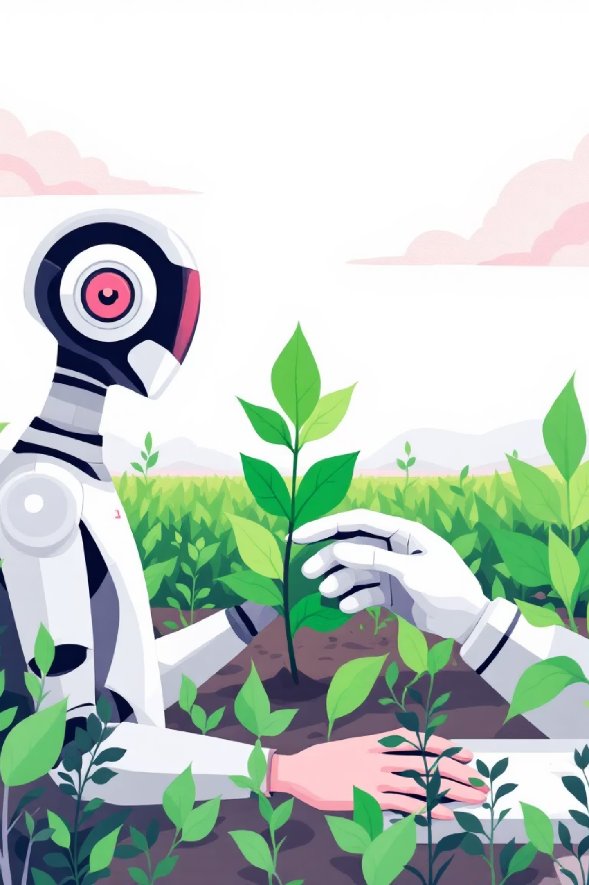

Crop-Disease-Detection: From Pixels to Diagnosis
Welcome to the Crop Disease Detection project! This intelligent system uses deep learning to identify diseases in plant leaves, helping farmers and botanists protect their crops and increase yields.
Shubham Pandey

Slide 2

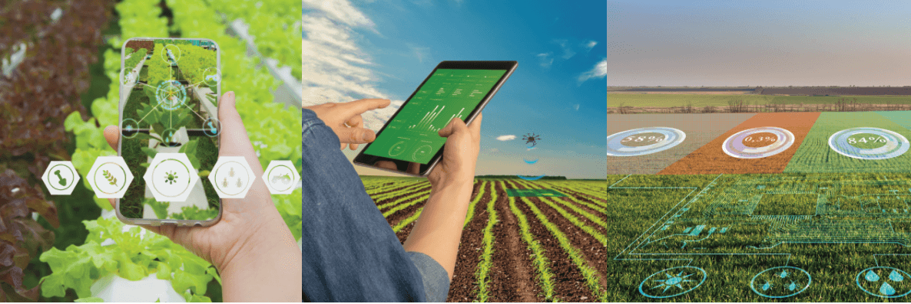
The Crop Guardian AI
Have you ever wondered if an AI could tell a healthy leaf from a sick one just by looking at it? This project answers that question by building a powerful image classification model that instantly recognizes and diagnoses common plant diseases.

Slide 3
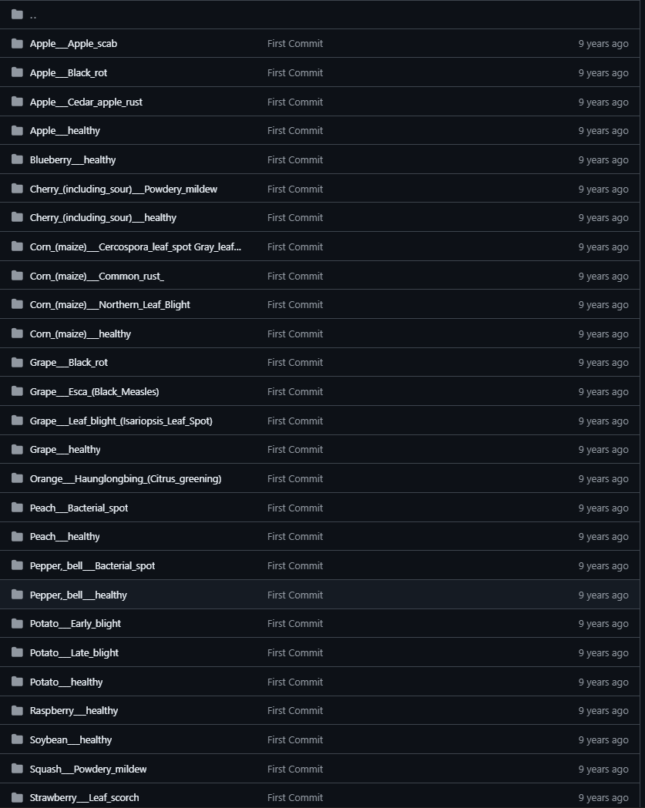
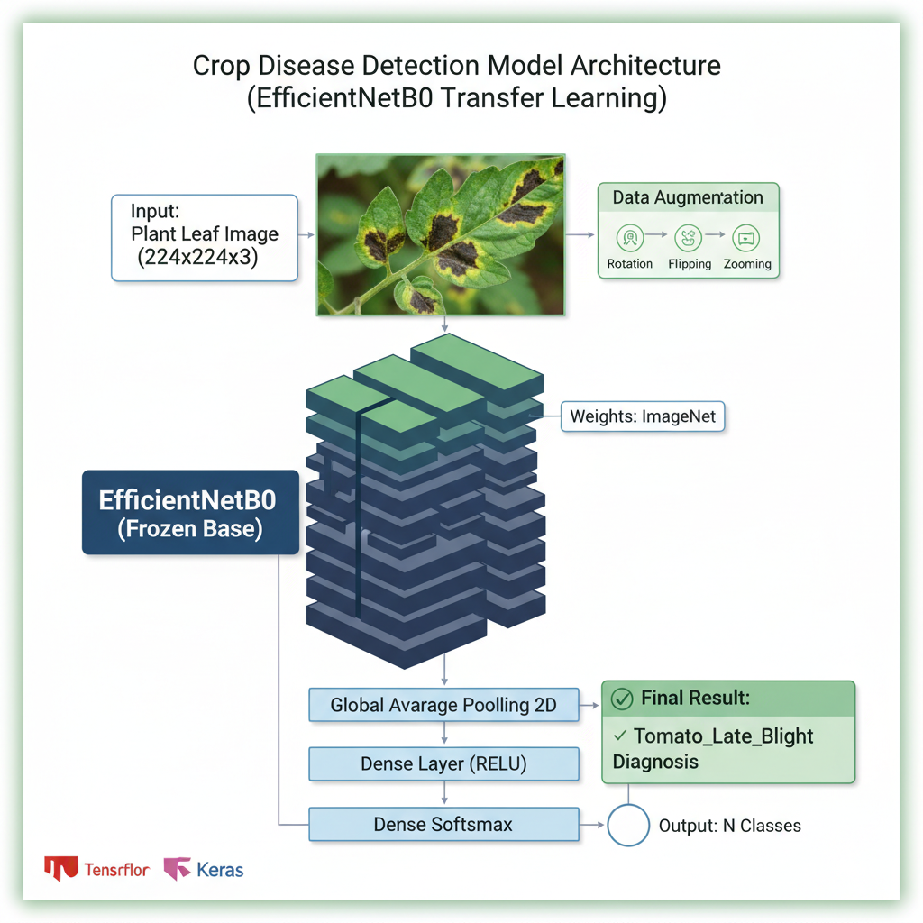
Project Highlights: Dataset & Model
Dataset
Model Architecture
The project utilizes the extensive PlantVillage-Dataset, a comprehensive collection of plant leaf images,
At github repo: https://github.com/spMohanty/PlantVillage-Dataset
We employ a Convolutional Neural Network (CNN), the leading architecture for image classification. This includes a custom-built CNN and an advanced transfer learning approach using a pre-trained EfficientNetB0 model.

Slide 4


Core Technologies Powering the Project
TensorFlow & Keras
Numpy & Matplotlib
The core frameworks for building and deploying our deep learning models.
Essential for numerical operations and visualizing model performance and data.
Scikit-learn
ImageDataGenerator
Used for generating detailed classification reports and confusion matrices to evaluate model accuracy.
Our workhorse for efficient data preprocessing and loading, ensuring smooth data flow to the model.

Slide 5
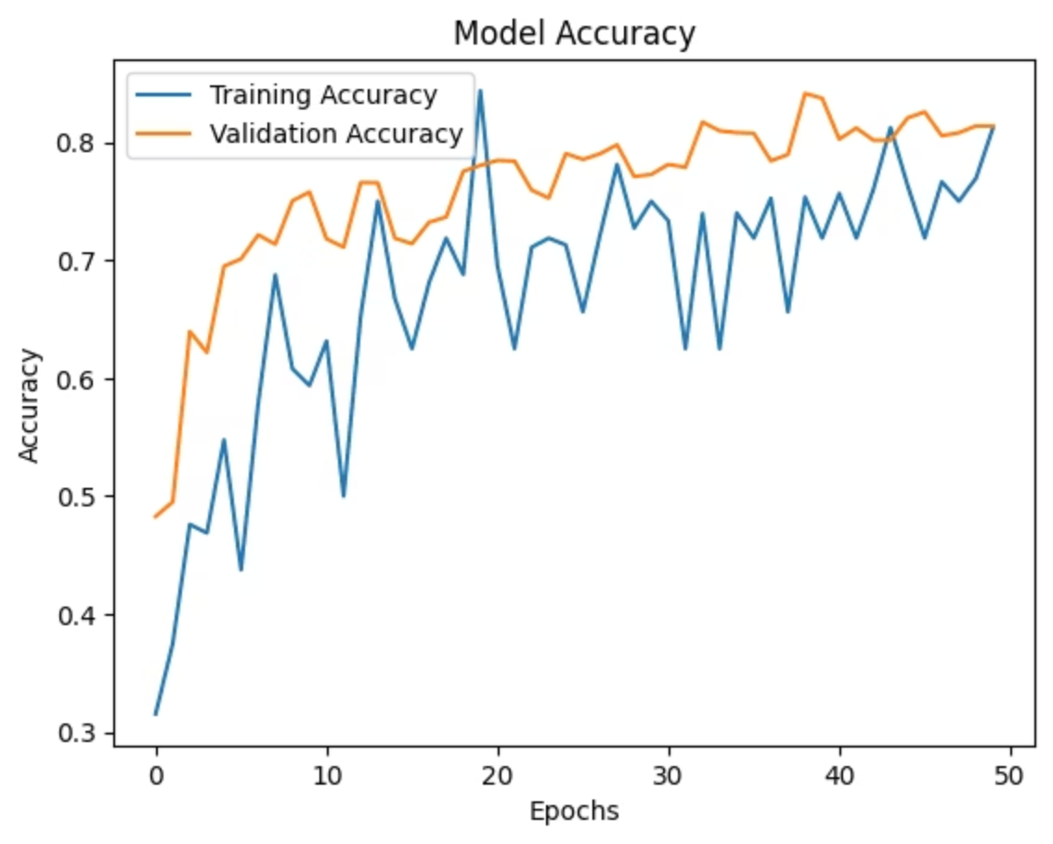
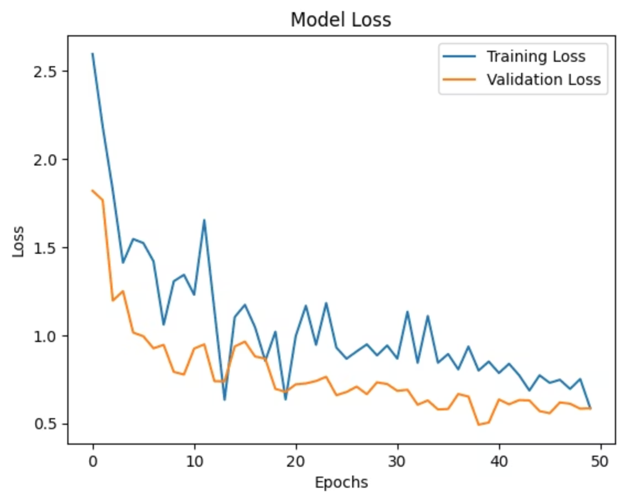
Model Performance & Evaluation
After rigorous training, our model demonstrates promising results in accurately identifying crop diseases. The following metrics highlight its performance at the last epoch:
Accuracy
0.8125
Loss
0.5851
Validation Accuracy
0.8138
Validation Loss
0.5858

Slide 6
Accessing the Model and Running Locally
Download the Model
Clone the Repository
Pull Docker Container
Access the pre-trained model directly from our Google Drive link for immediate use in your projects.
git clone https://github.com/ShubhamP1028/Crop-Disease-Detection.git
docker pull newbieshubham/crop-
disease-detection:latest
Download Model
docker run -d --name PDD -p 5030
:5030 newbieshubham/crop-diseas
e-detection:latest
Get the entire project codebase by cloning the GitHub repository.

Slide 7
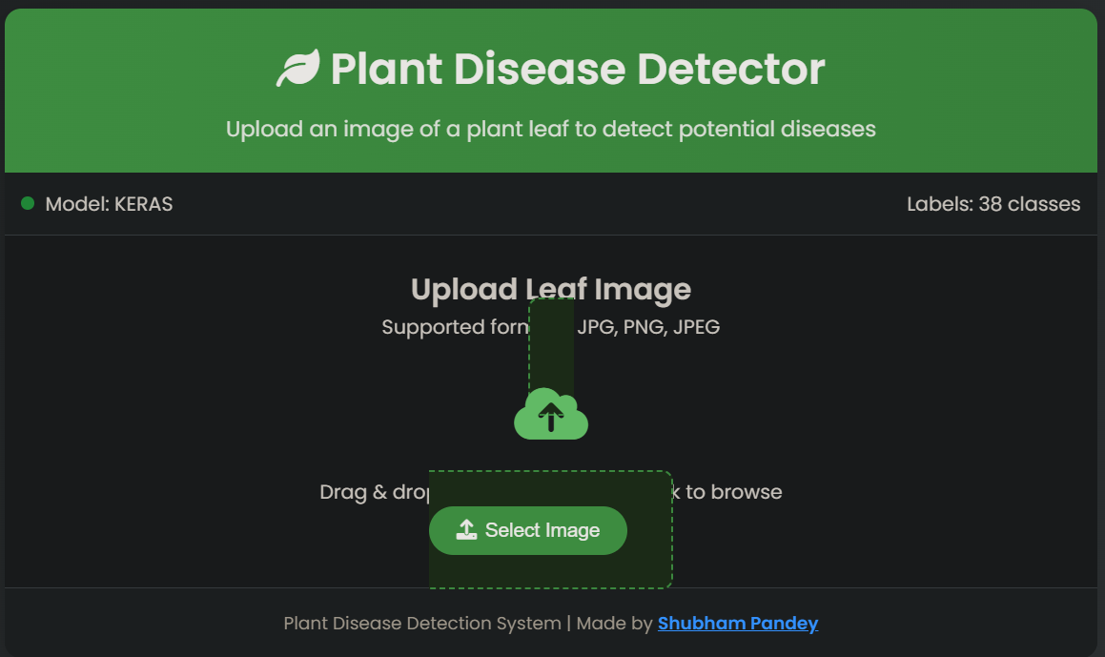
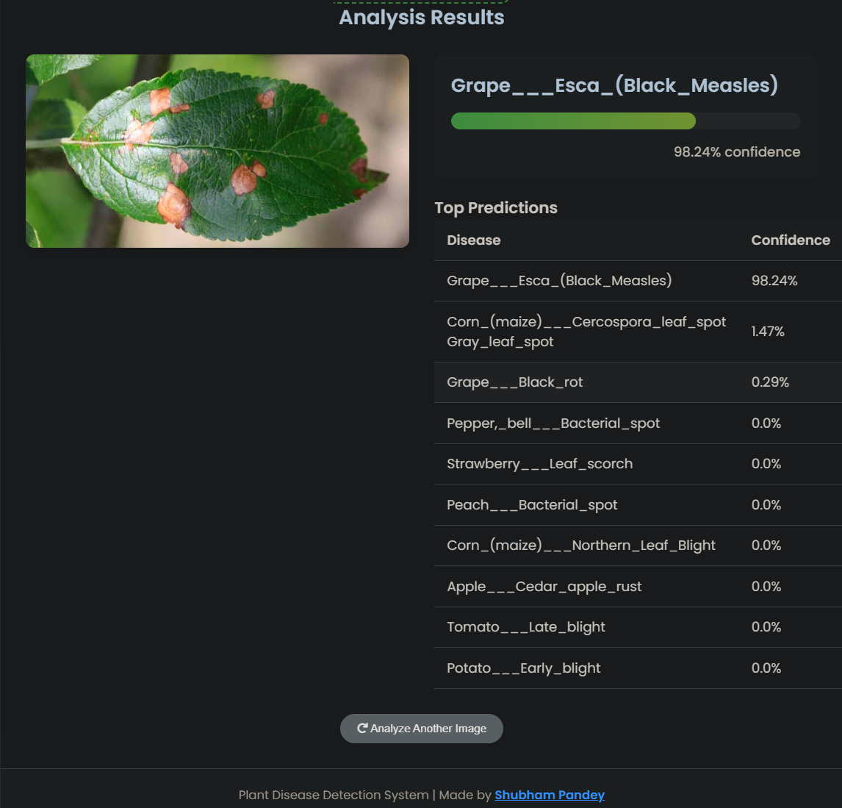

Project Overview: Languages Used
This project leverages a combination of programming languages, with a strong emphasis on Jupyter Notebook for development and analysis.
The majority of the project's logic and experimentation is conducted within Jupyter Notebooks, complemented by HTML for web components and Python for core scripting.

Slide 8

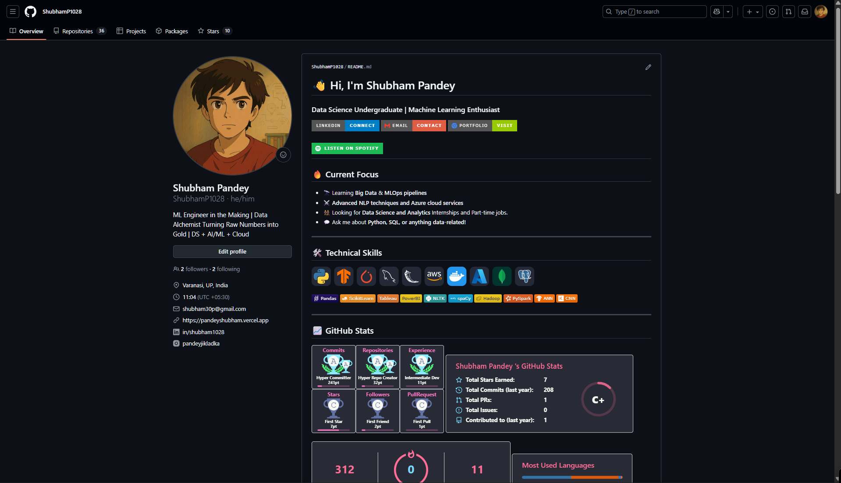

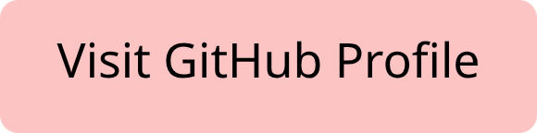
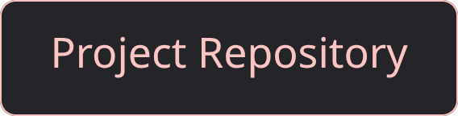
Connect with Me
Explore more of my work and contributions on GitHub.

